Slide 1
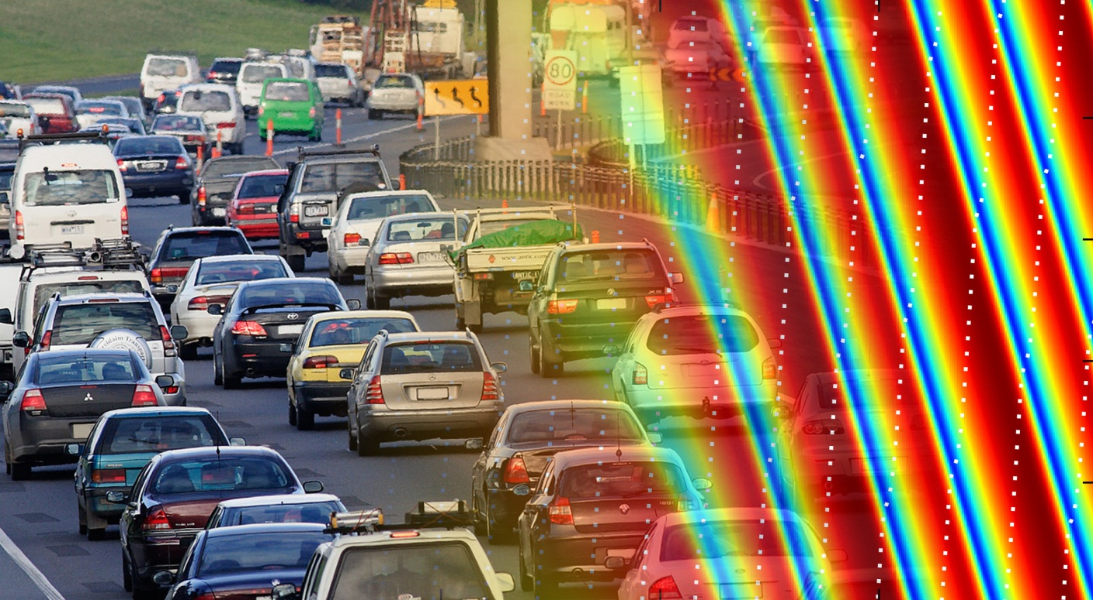
Phase transition in the Intelligent Driver Model induced by interaction exponent

Slide 2
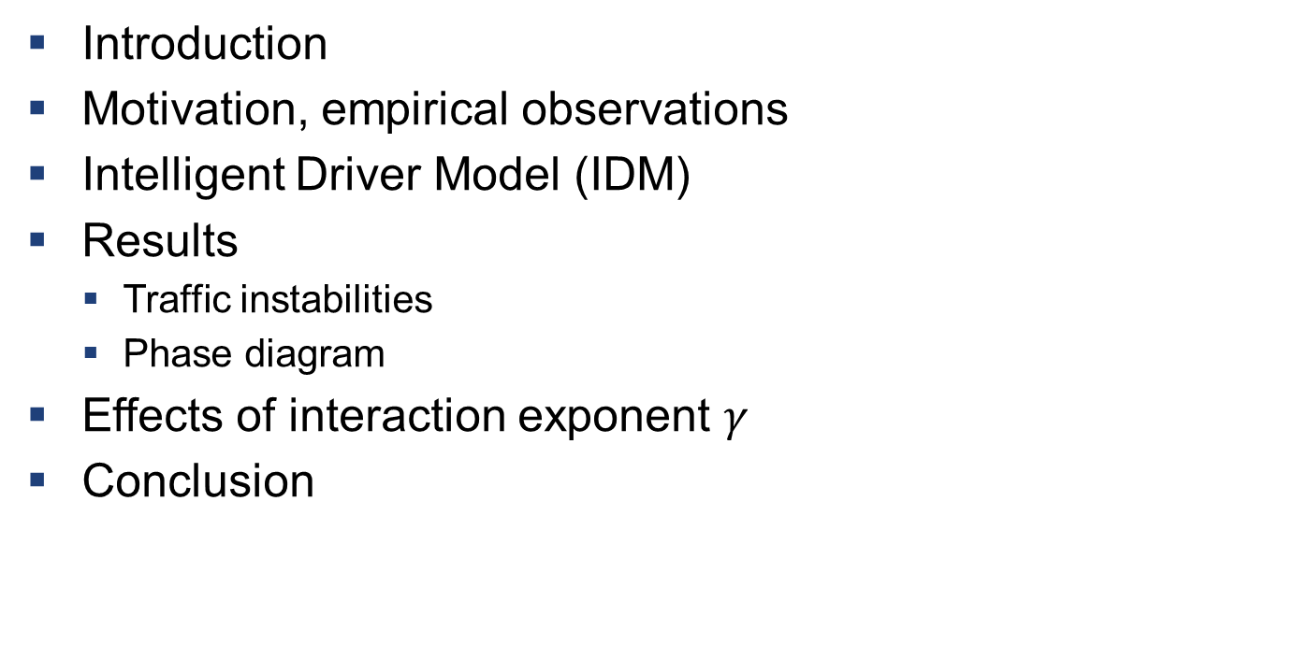
Overview
Introduction
Motivation, empirical observations
Intelligent Driver Model (IDM)
Results
Traffic instabilities
Phase diagram
Effects of interaction exponent $γ$
Conclusion

Slide 3
Introduction
We want to understand traffic dynamics
Existing computer models can emulate emergence of stop-and-go waves
How do acceleration and breaking strategies affect traffic stability?

Slide 4
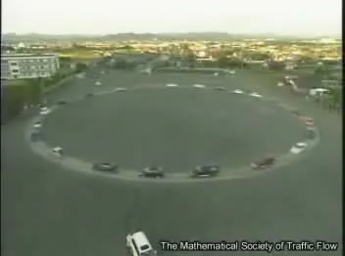
Experimental observation of instability
Nakayama et al. New Journal of Phys. 2009 [1]

Slide 5
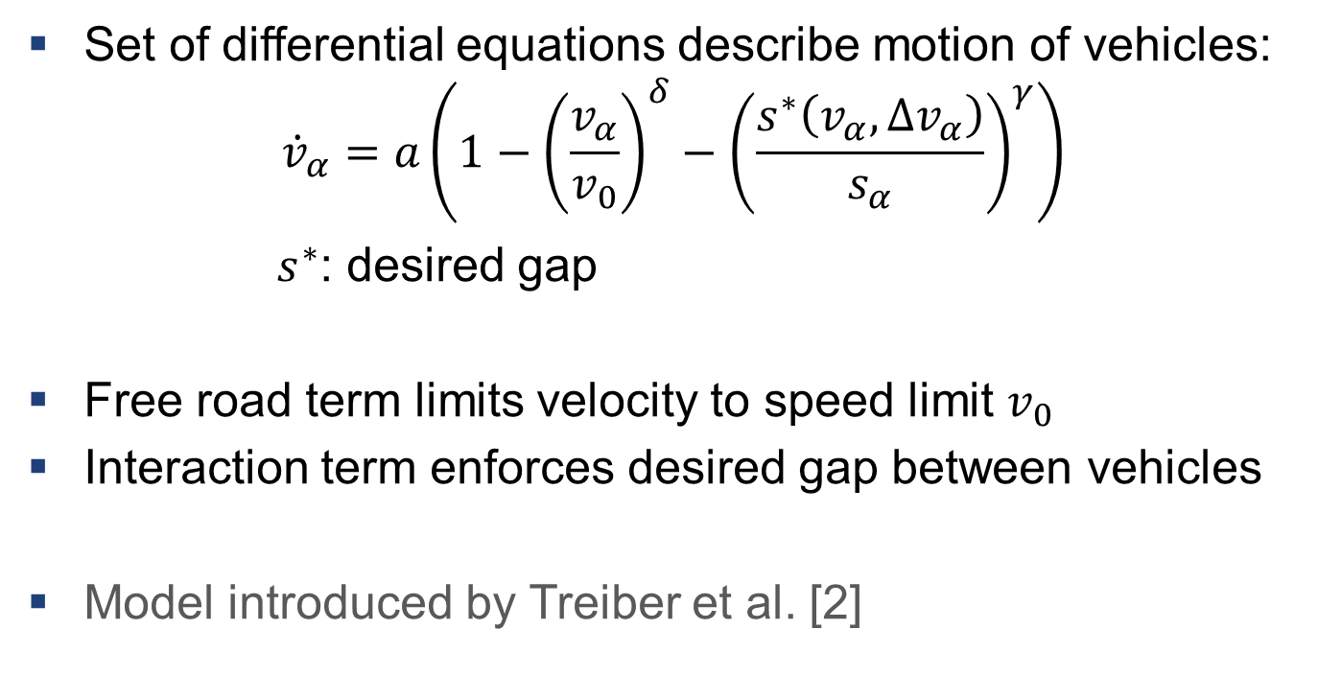
Intelligent Driver Model (IDM)
Set of differential equations describe motion of vehicles:
$${\dot{v}}_{α}=a\left(1−{\left(\frac{v_{α}}{v_{0}}\right)}^{δ}−{\left(\frac{s^{∗}\left(v_{α},Δv_{α}\right)}{s_{α}}\right)}^{γ}\right)$$
$s^{∗}$: desired gap
Free road term limits velocity to speed limit $v_{0}$
Interaction term enforces desired gap between vehicles
Model introduced by Treiber et al. [2]

Slide 6
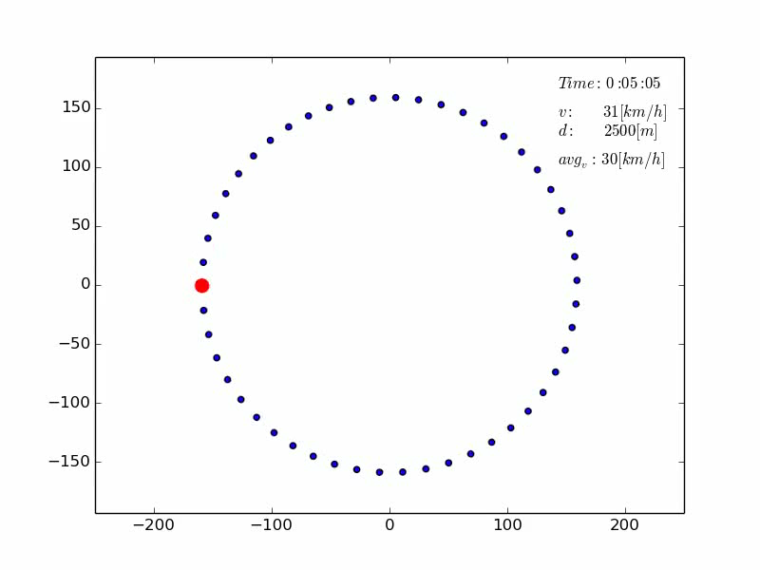
Simulated traffic instability

Slide 7
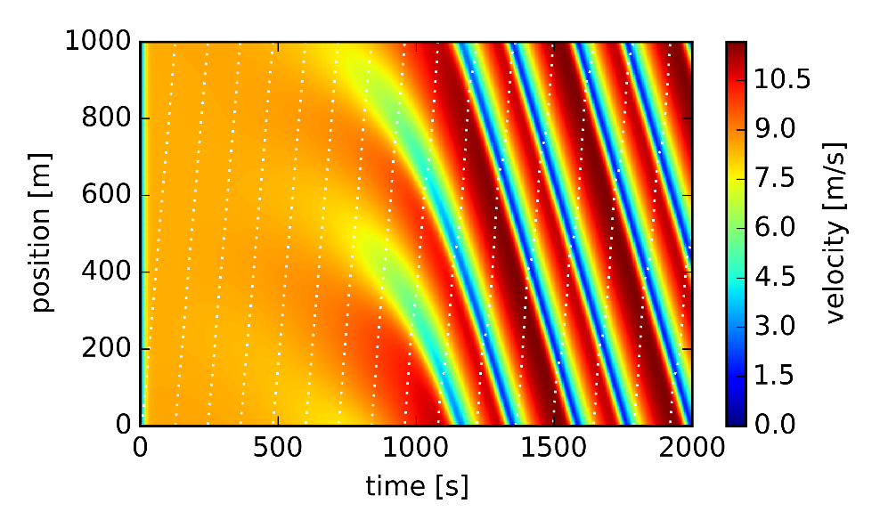
Simulated traffic instability
Traffic flow initially evolves homogeneously
Spontaneous rise of the instabilities
Instabilities manifest in the form of stop-and-go waves
Stop-and-go waves travel opposite to the vehicle flow
Instability is equilibrium condition
Spatio-temporal representation of velocity distribution

Slide 8
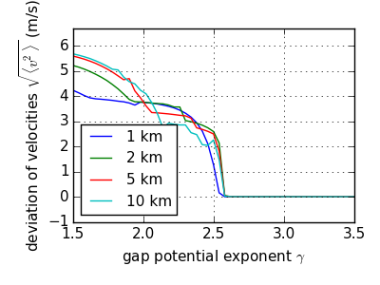
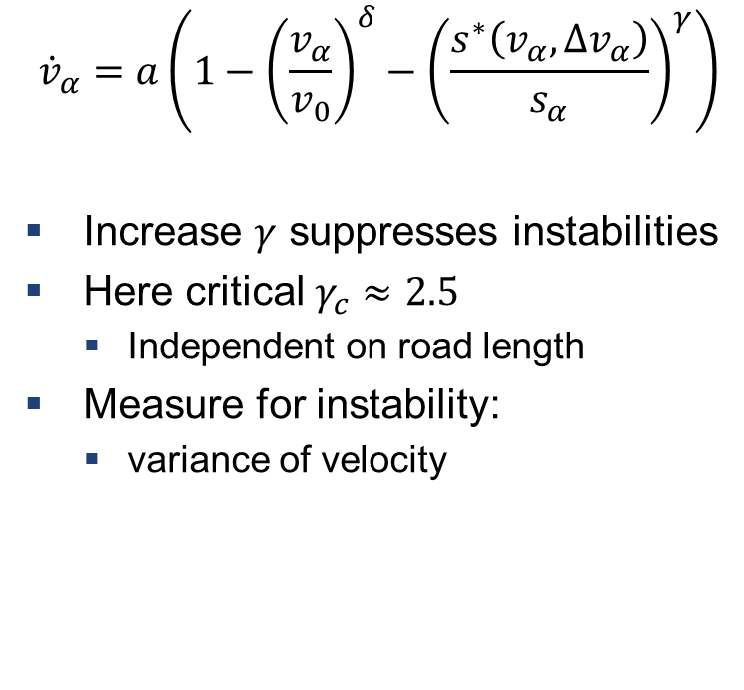
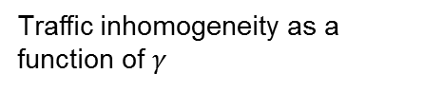

Interaction exponent $γ$
$${\dot{v}}_{α}=a\left(1−{\left(\frac{v_{α}}{v_{0}}\right)}^{δ}−{\left(\frac{s^{∗}\left(v_{α},Δv_{α}\right)}{s_{α}}\right)}^{γ}\right)$$
Increase $γ$ suppresses instabilities
Here critical $γ_{c}≈2.5$
Independent on road length
Measure for instability:
variance of velocity
Traffic inhomogeneity as a function of $γ$

Slide 9
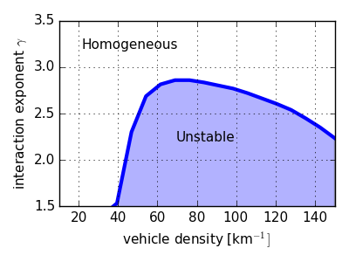

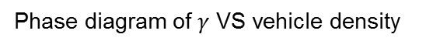
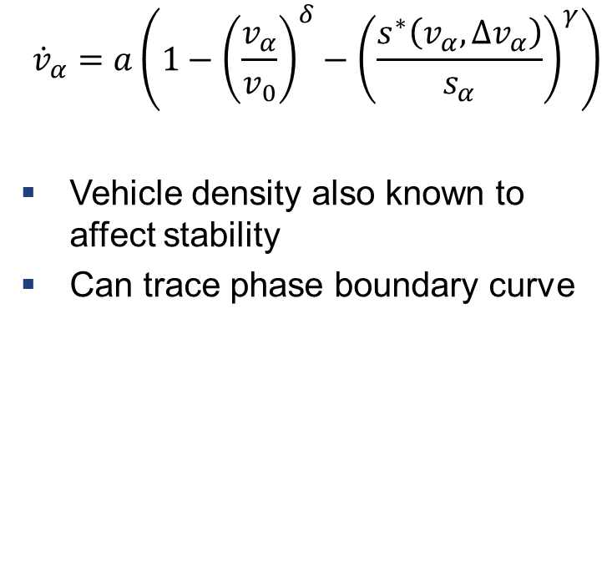
Interaction exponent $γ$: phase diagram
$${\dot{v}}_{α}=a\left(1−{\left(\frac{v_{α}}{v_{0}}\right)}^{δ}−{\left(\frac{s^{∗}\left(v_{α},Δv_{α}\right)}{s_{α}}\right)}^{γ}\right)$$
Vehicle density also known to affect stability
Can trace phase boundary curve
Phase diagram of $γ$ VS vehicle density

Slide 10


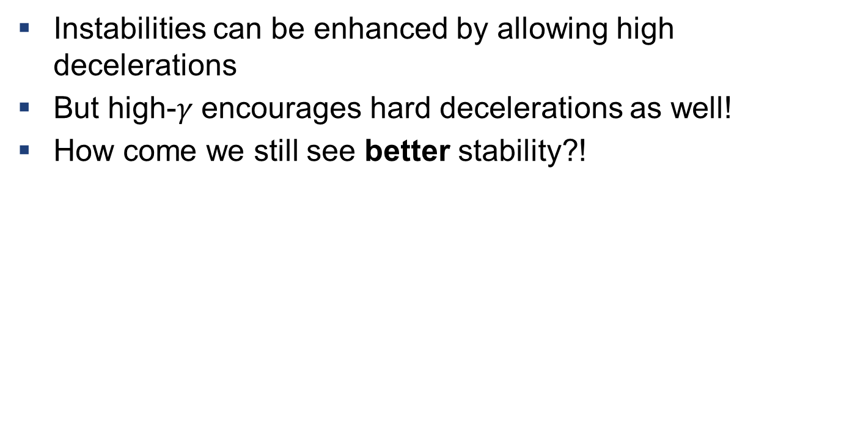
Exponent $γ$ affects stability, but why?
Instabilities can be enhanced by allowing high decelerations
But high-$γ$ encourages hard decelerations as well!
How come we still see better stability?!

Slide 11
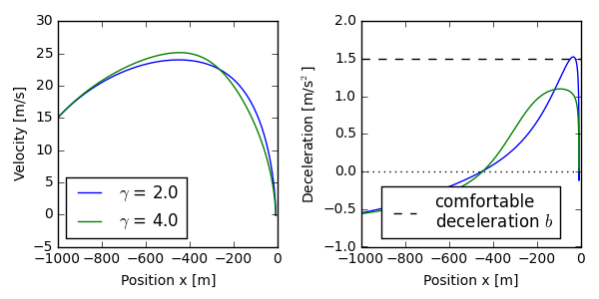

Breaking behaviour
Breaking profiles when approaching standing obstacle
Low gamma driver breaks late and hard
High gamma driver breaks earlier
Information about obstacle spreads faster to other drivers

Slide 12
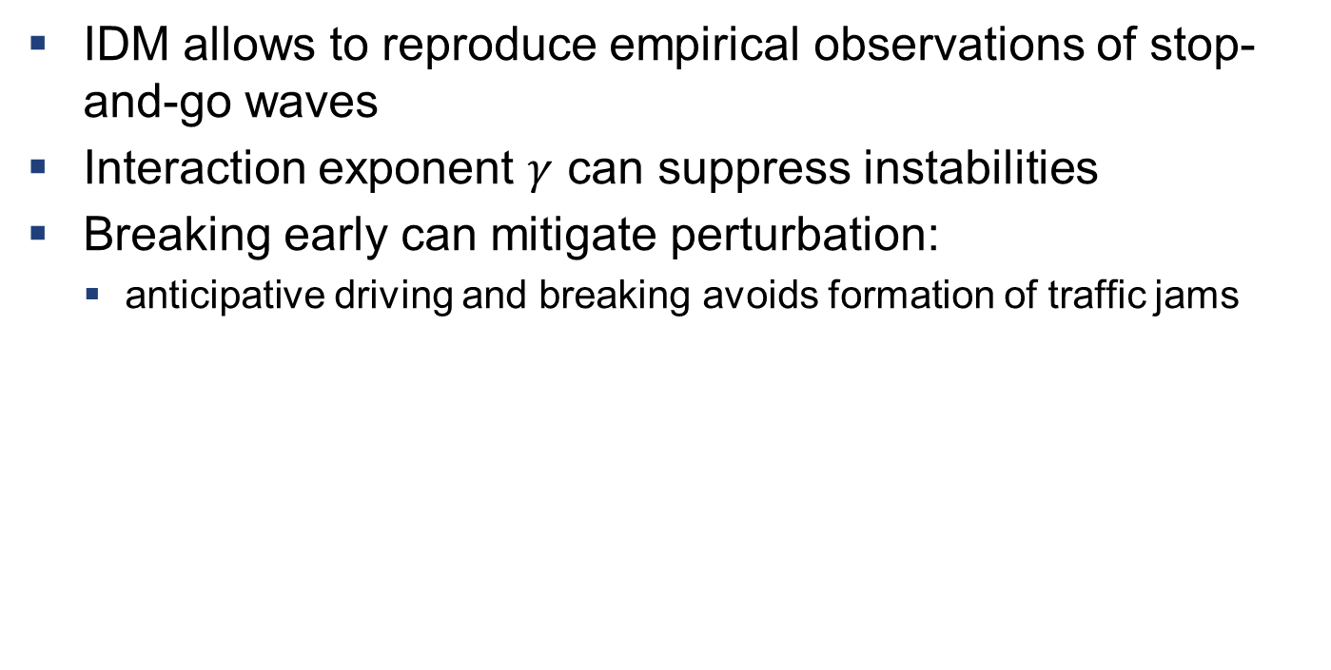
Conclusions
IDM allows to reproduce empirical observations of stop-and-go waves
Interaction exponent $γ$ can suppress instabilities
Breaking early can mitigate perturbation:
anticipative driving and breaking avoids formation of traffic jams

Slide 13
References
[1] Nakayama et al. Metastability in the formation of an experimental trac jam. New Journal of Physics, 11(8):083025, 2009.
[2] Martin Treiber and Dirk Helbing. Explanation of observed features of self-organization in traffic flow. arXiv preprint cond-mat/9901239, 1999.

